Slide 1
Git Hub Account

Slide 2
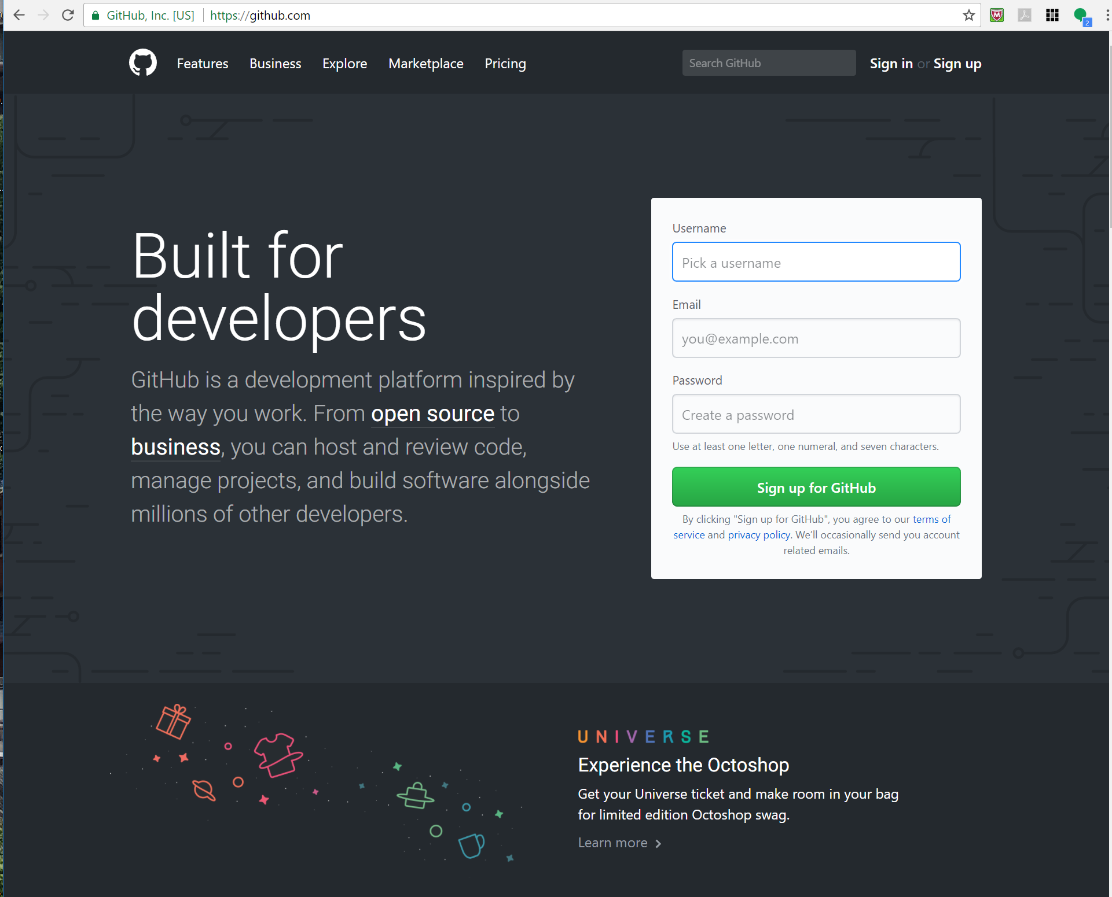
Create Git Hub Account
www.github.com
Fill out the Username, Email and Password.
Once you have an account, send me the email and username used for signup

Slide 3
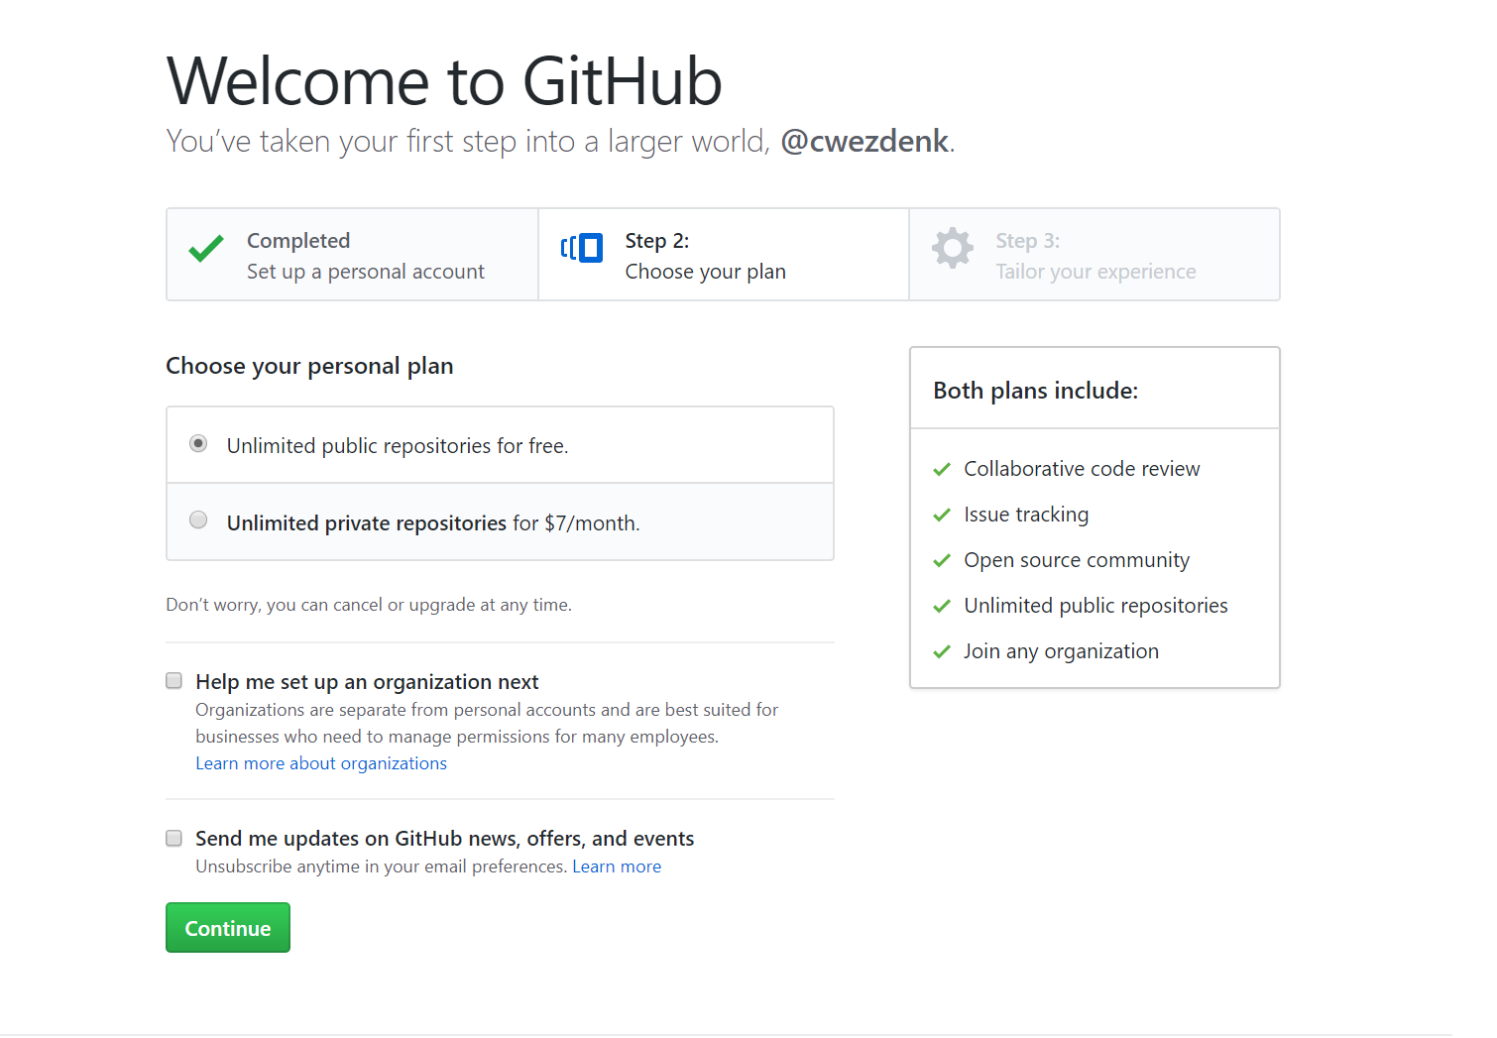
Create Git Hub Account
Choose “Unlimited public repositories for free.”

Slide 4
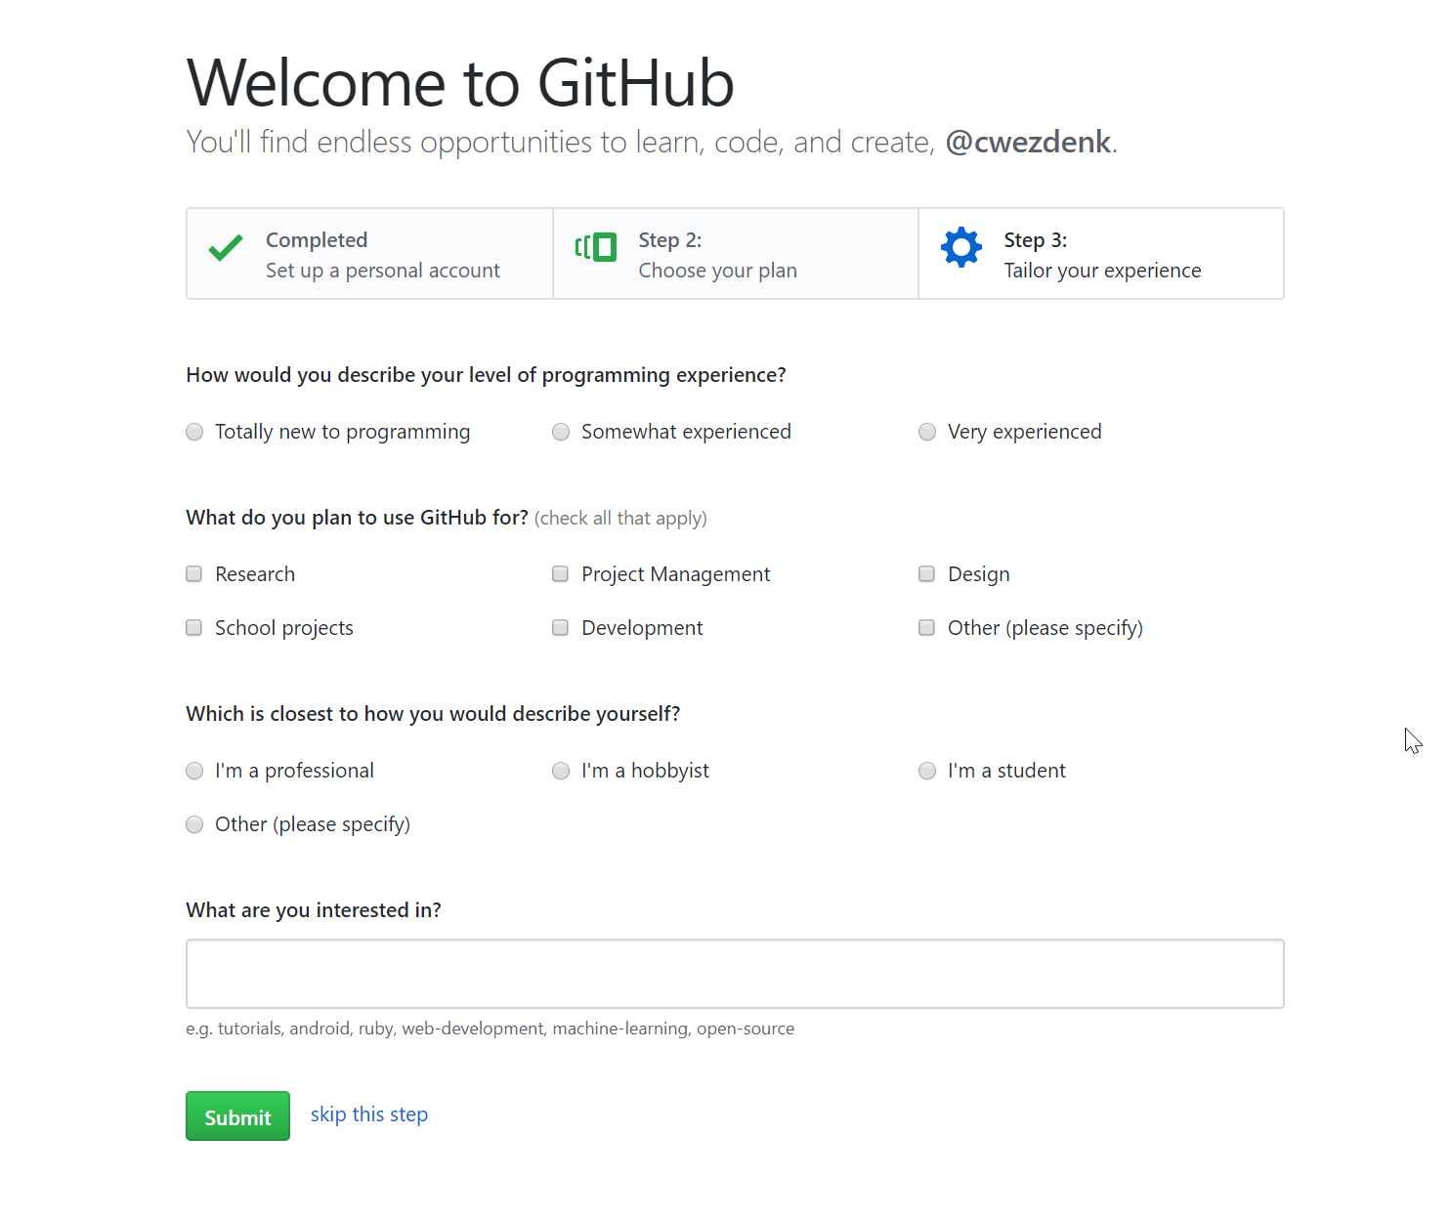
Create Git Hub Account
I normally skip this step on this page.

Slide 5
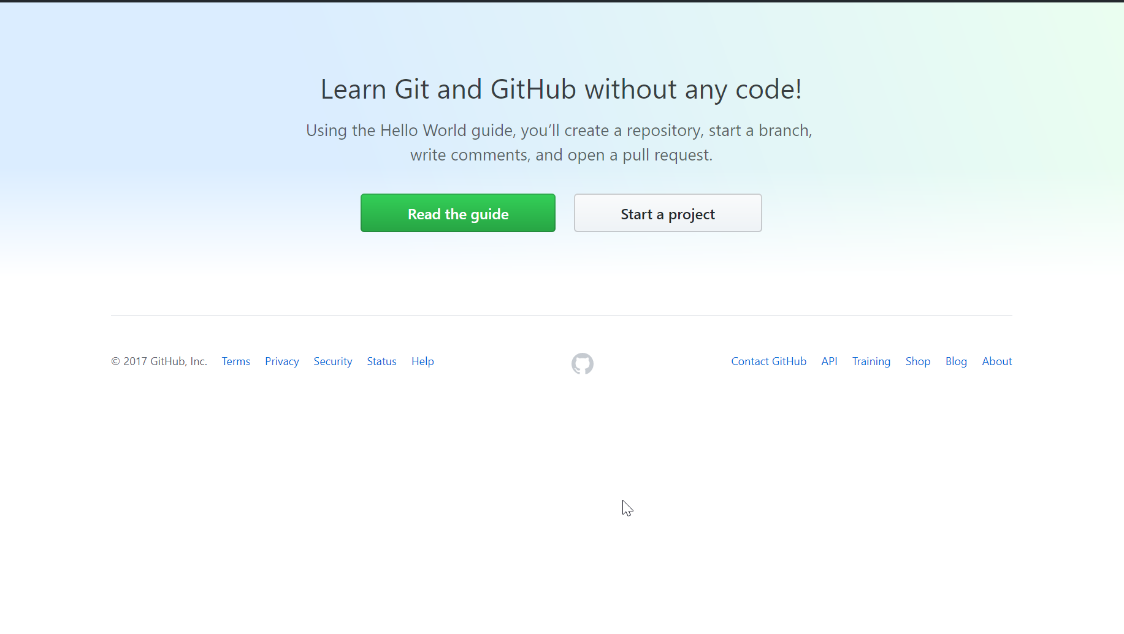
Create Git Hub Account
Should see this now
You will get an email to verify your account

Slide 6
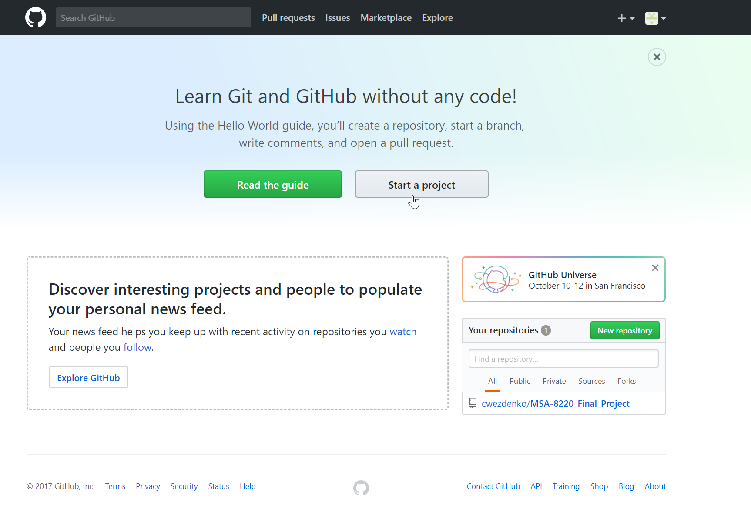
Adding the MSA-8220_Final_Project to you profile
With you email and username, I will add you as a contributor to the project.
When you receive the email, click the link to accept the invitation.
Once the invitation is accepted, the project will show up under “Your Repositories”

Slide 7
Accessing and saving the files
You can use the web interface to access the files and upload changes, but the desktop app is much easier
https://desktop.github.com/
Download the app (windows or mac)

Slide 8
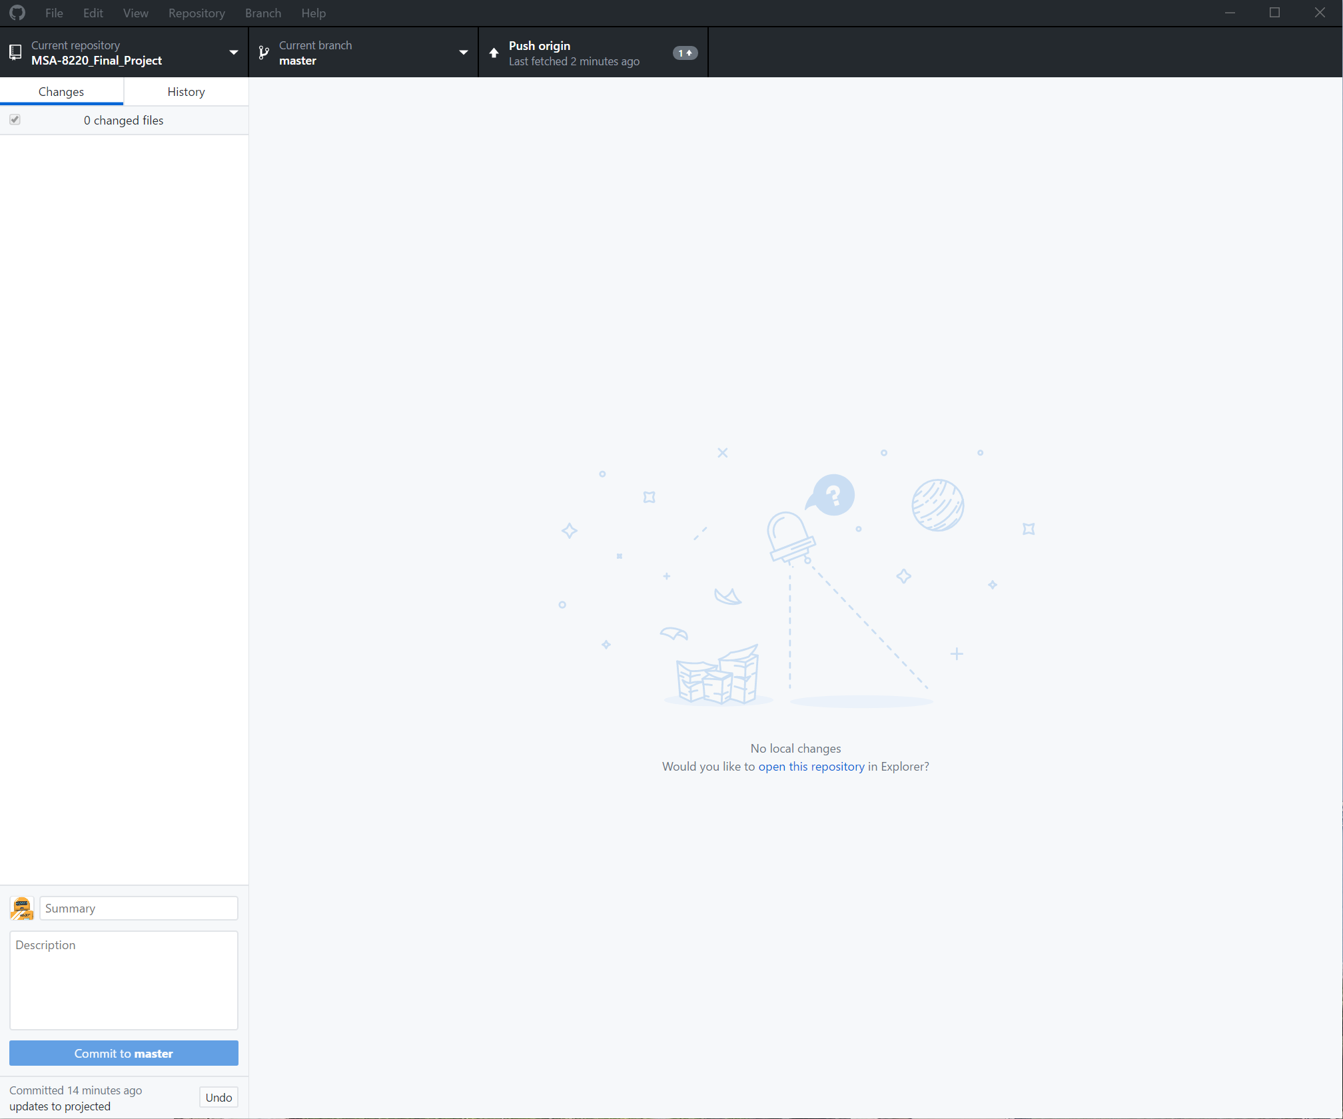
GitHub Desktop
Once installed, the app will look like this:

Slide 9
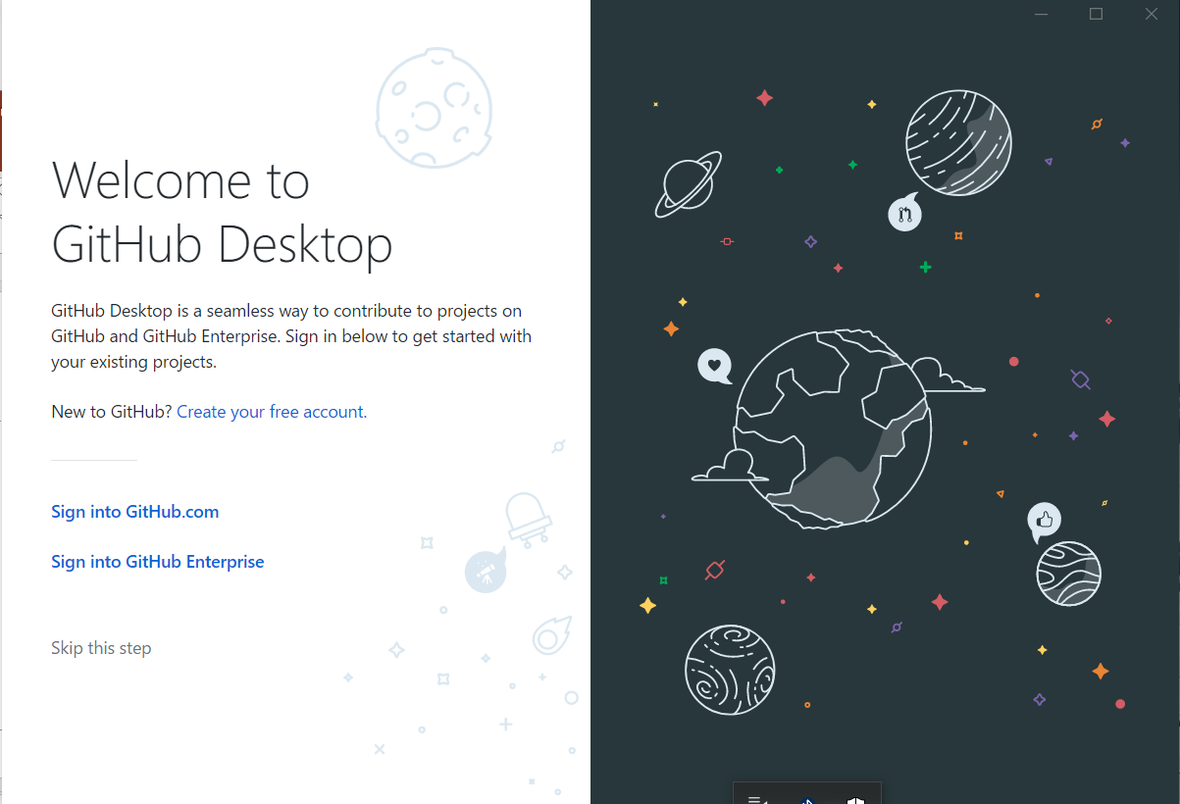
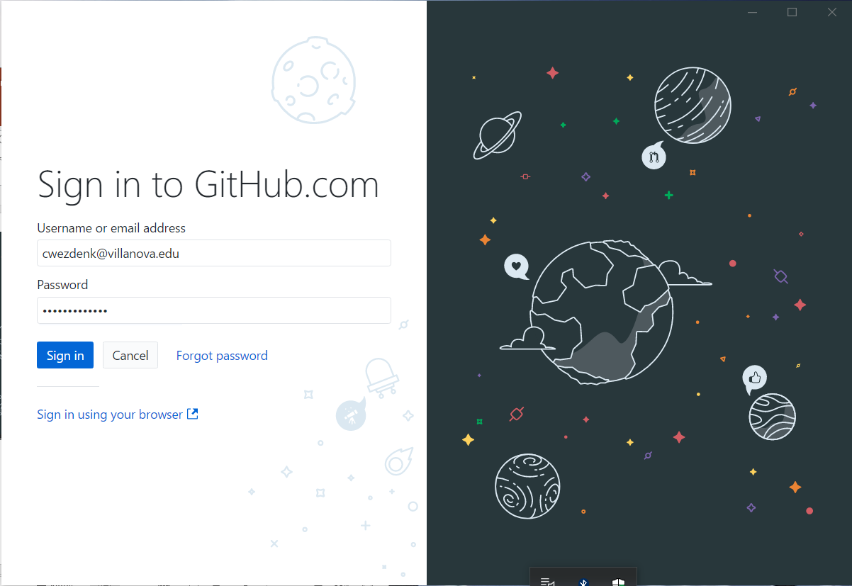
Sign in to Git Hub Desktop
Choose sign into github.com
Enter credentials (same as github.com)

Slide 10
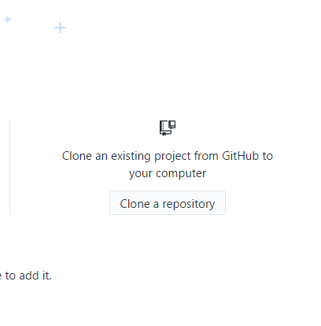
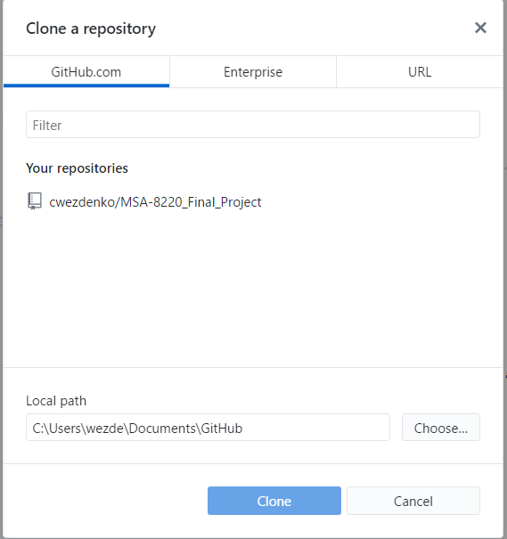
Add final project to local machine
Click “Clone a repository”
Select “cwezdenko/MSA-8220_Final_Project”
Select Clone (if you do not like the location where the final project files are going, you can change it before selecting the clone button)

Slide 11
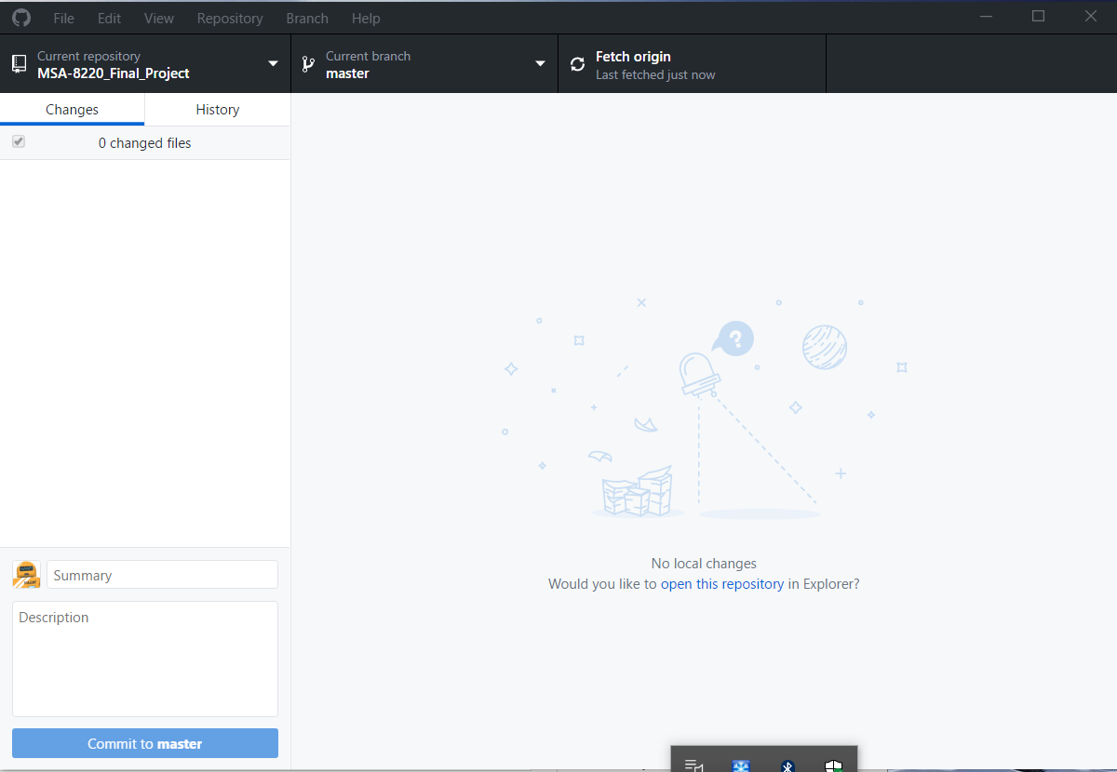
Project is now added
Any changes will be detected by the GitHub app and can be committed back to the master branch.
Other user will be able to see when changes hit the master branch and can download those changes.
Collisions will still be an issue and will have to be resolved during the upload process from the local computer to the github.com server repository

